Slide 1
DEVELOPMENT OF AN E-COMMERCE WEBSITE FOR ONLINE SHOPPING
Name: MD. MAHBUBUL HASAN
ID: 1611076116
Session: 2015-16
Course code: CSE 4292
Dept. of Computer Science & Engg.

Slide 2
Objective
The present work is done to fulfill the following objectives:
To study the different commercial web sites in the internet and get idea about the construction, component and mechanism of a commerce site
The different requirements for doing E-commerce are presented A commercial web site includes many phases with different needs These requirements are studied in detail.
Understanding the Web programming concept. HTML, server-side scripting, database programming. Socket programming are studied to develop the web site.
Network infrastructure for Electronic is covered. Requirements to host a commercial website are presented.

Slide 3
Scope of the Project
This system discusses how we can make E-commerce Site to monitor multiple business organization in one platform and customer can buy their product through this website.

Slide 4
Existing System & Its problem.
Existing System is a Manual Management System or most of the system made for individual.
Website maintenance is costly that’s why it is difficult for small retailer to open website.
Different website use for different kind of products that is difficult for users to search a specific product.

Slide 5
Proposed System
The Proposed System provides opportunity to the retailer to operate their business using this website.
This project contains three modules:Supper admin module, admin module and customer module.
Supper admin module is used to manage the admin panels, admin module can add, delete and update manufacture, categories or product. Customer module used to provide the feedback of the products and can create account for his/her.

Slide 6
Registered users can access the database of the products. Which will provide details about products and shops
The data can be accessed accurately.
This is a faster system.
This is a user-friendly system.

Slide 7
Required Front-End Tools
HTML 5
CSS 3
Jquery
Bootstrap 3.0

Slide 8
Required Back-End Tools
PHP 5
MySQL
Laravel 5.4
Ajax

Slide 9
Software Tools
Operating System: Windows 10
Web server: Apache
Text editor: Sublime Text3

Slide 10
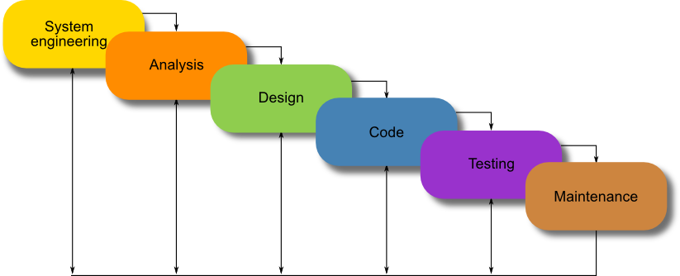
Software Development Model

Slide 11
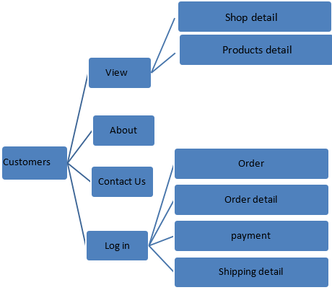
Functional Diagram

Slide 12
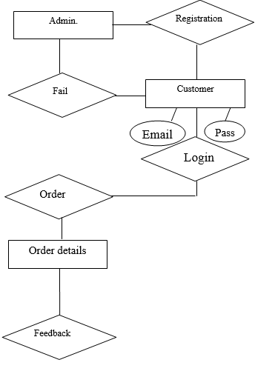
Entity Relationship Diagram

Slide 13
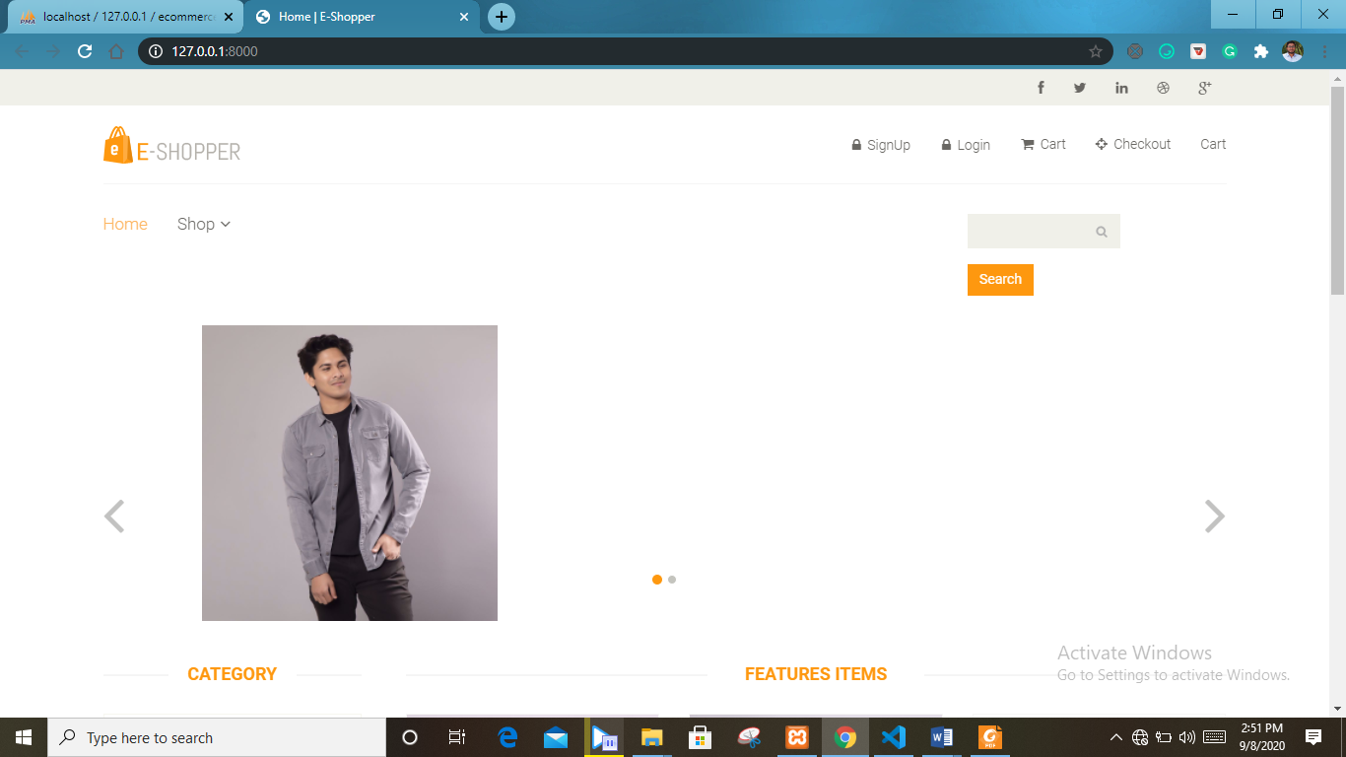
Home-page

Slide 14
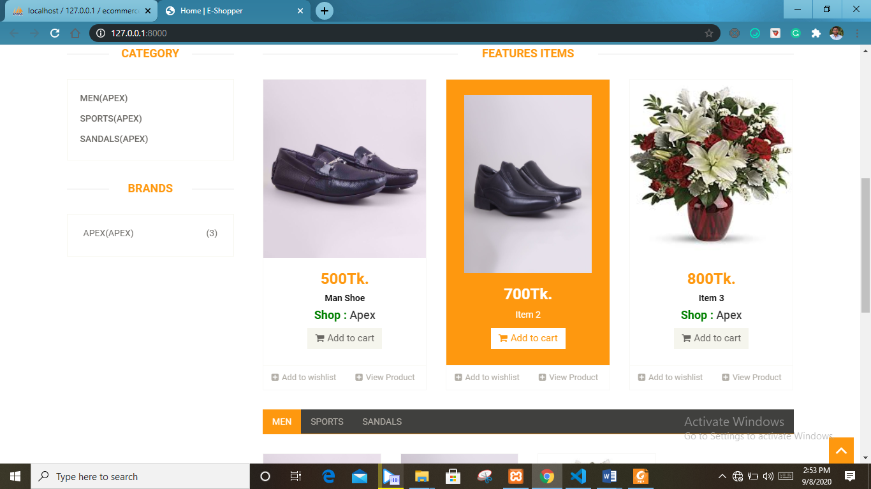
Product images

Slide 15
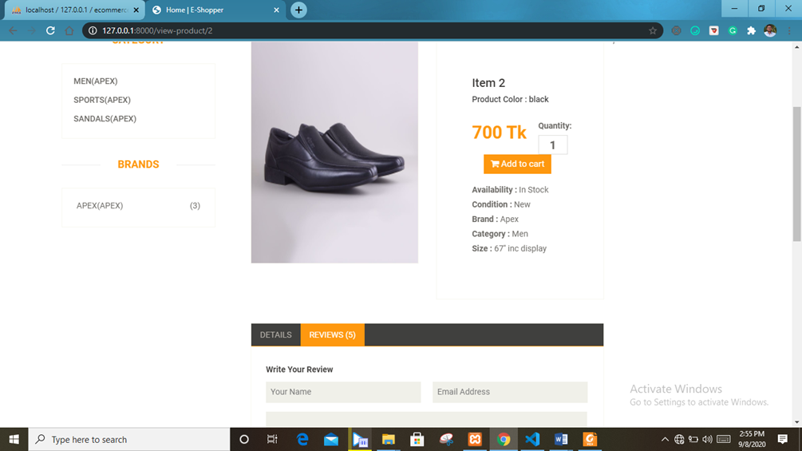
Product detail

Slide 16
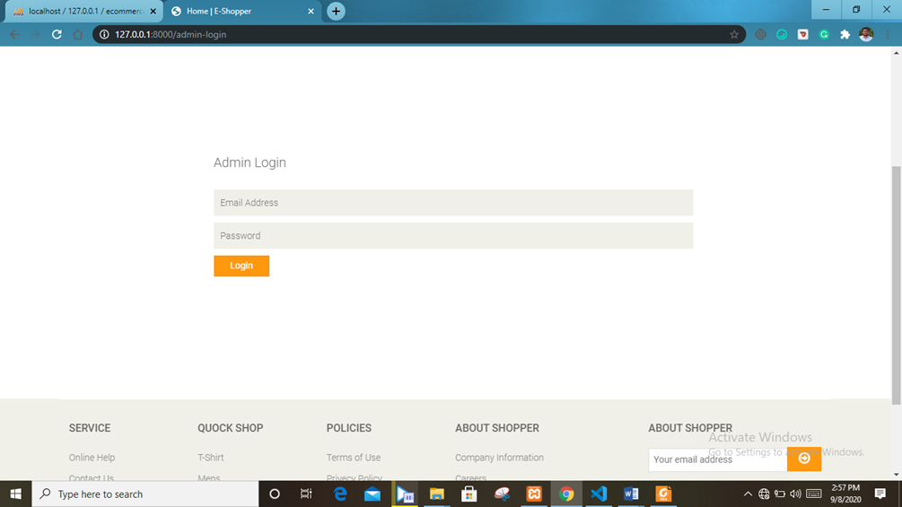
Admin login page

Slide 17
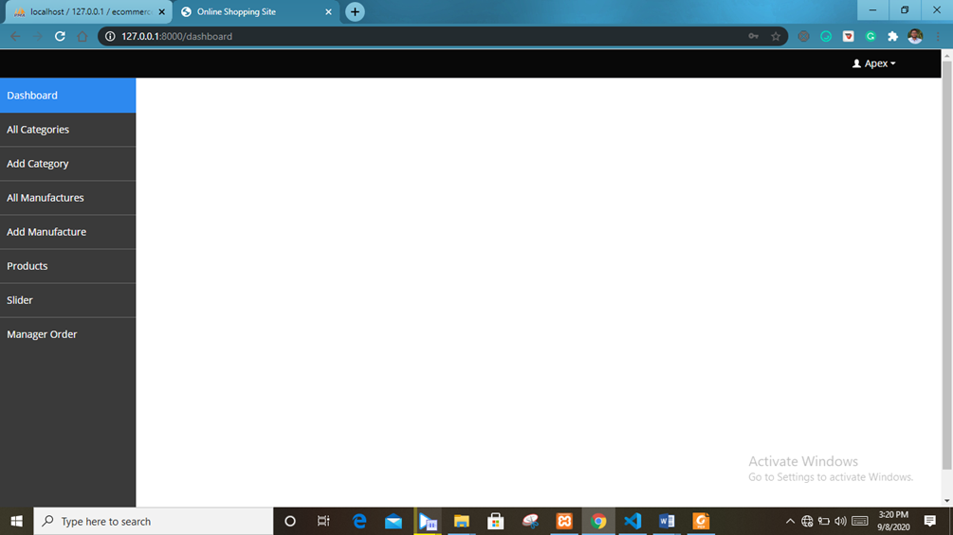
Admin fields

Slide 18

Users login page

Slide 19
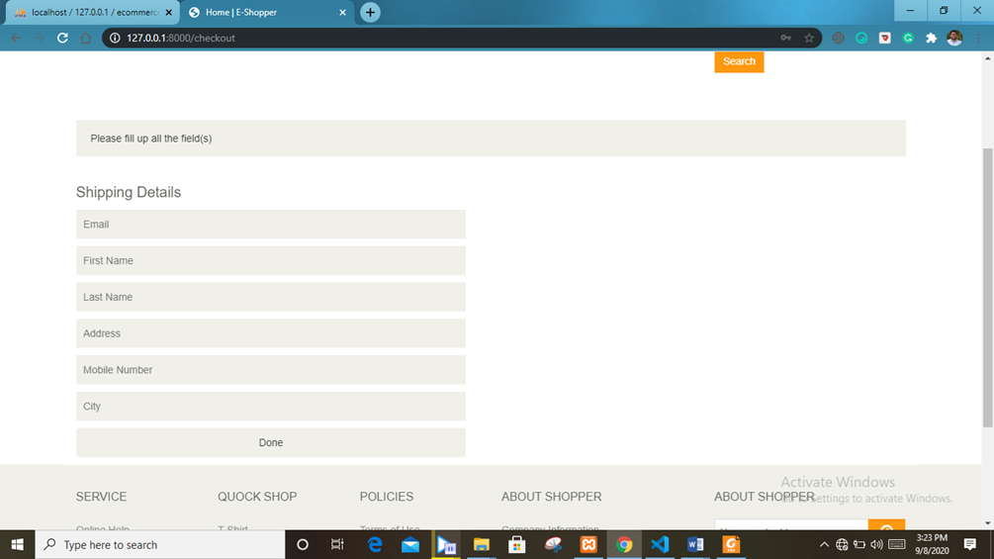
User fields

Slide 20
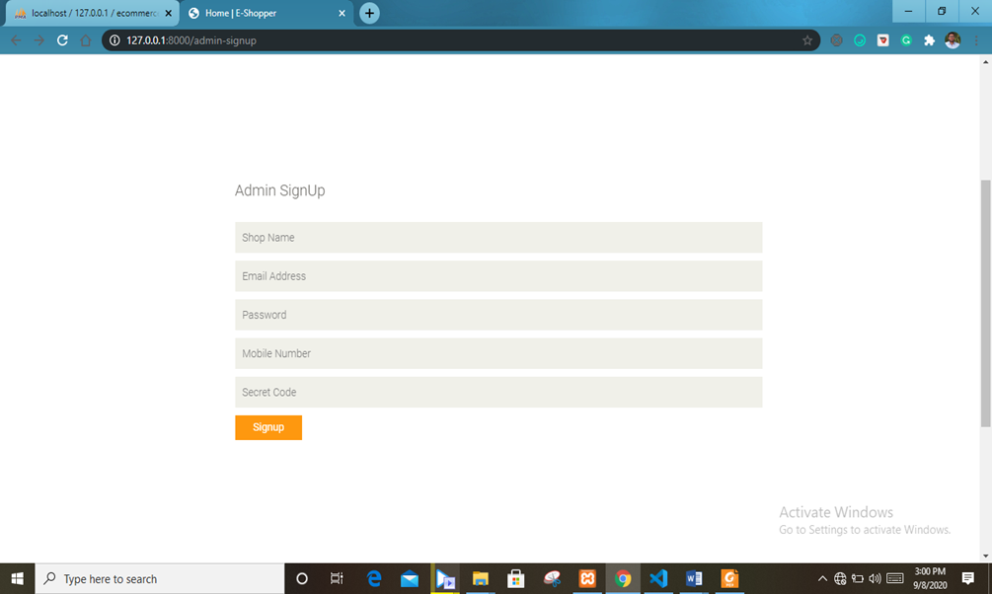
Admin signUp

Slide 21

User signUp

Slide 22
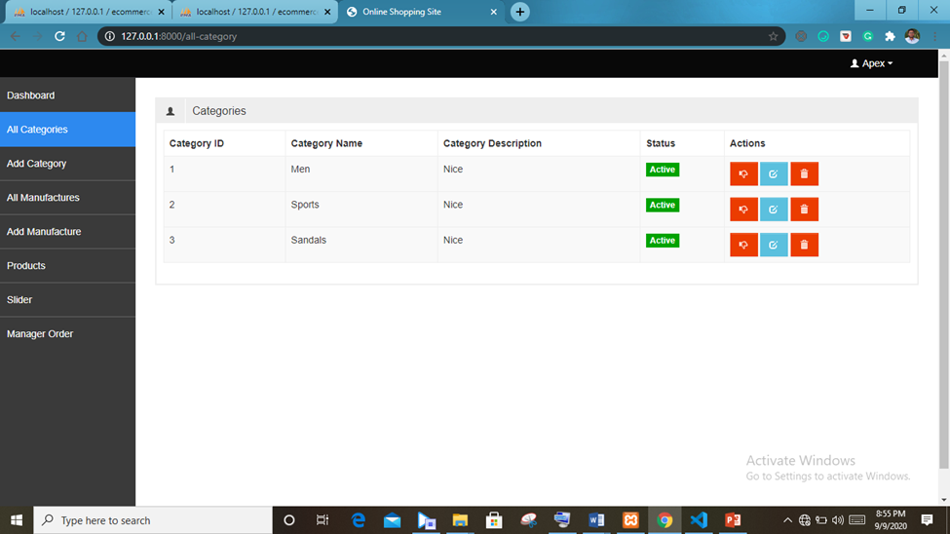
All categories

Slide 23
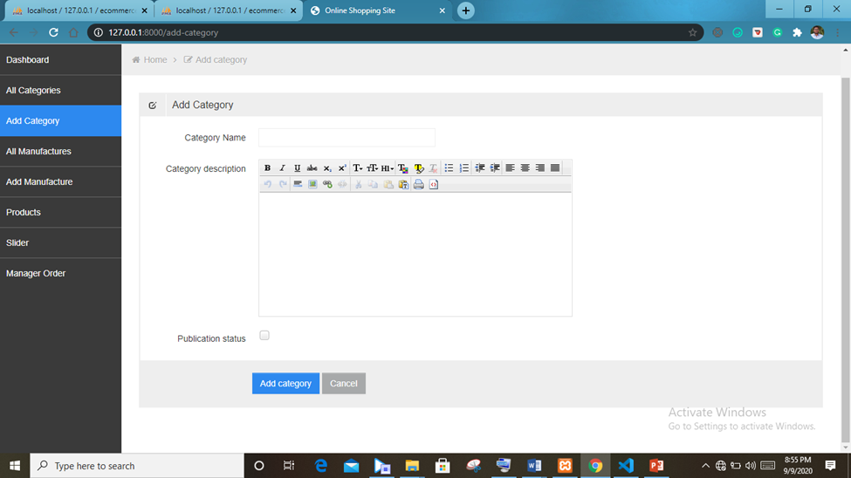
Add categories

Slide 24
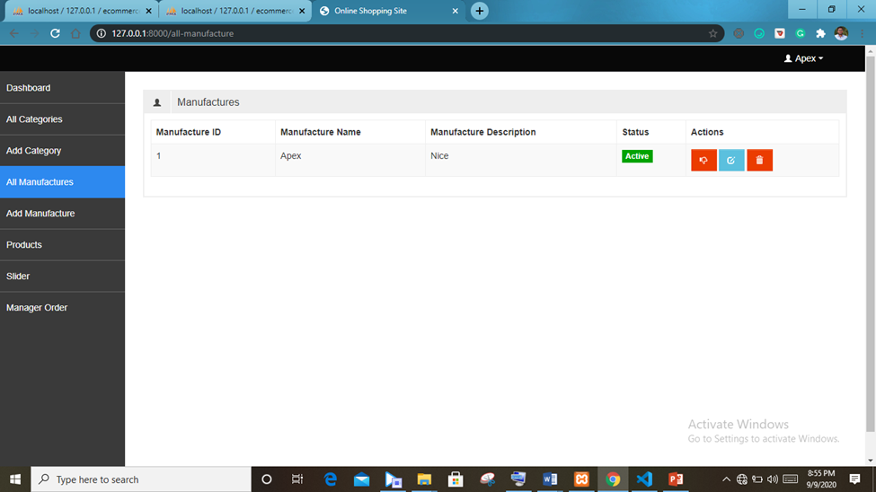
All manufacture

Slide 25
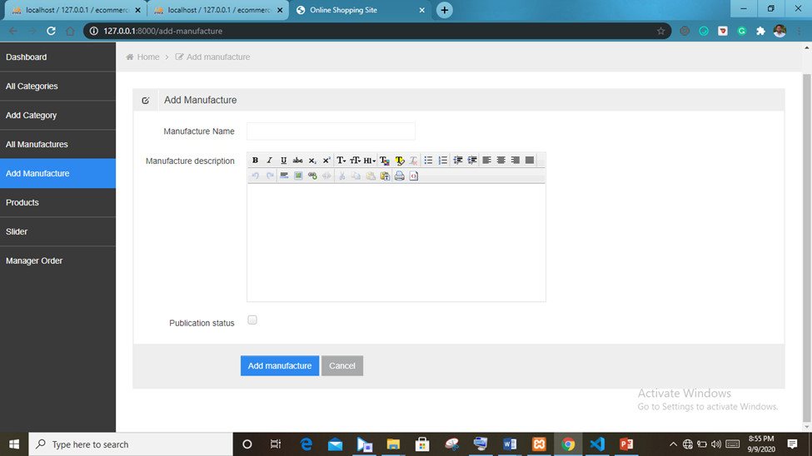
Add manufacture

Slide 26
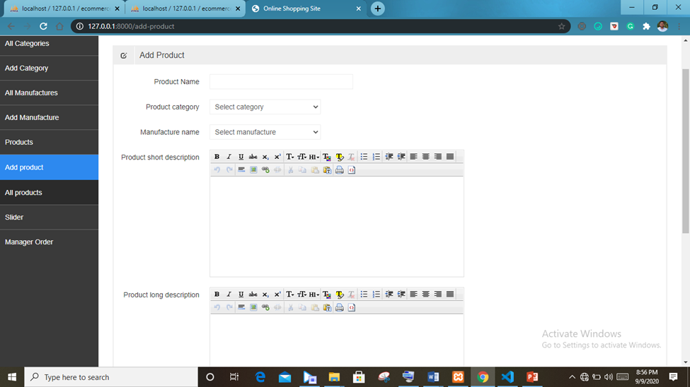
Add products

Slide 27
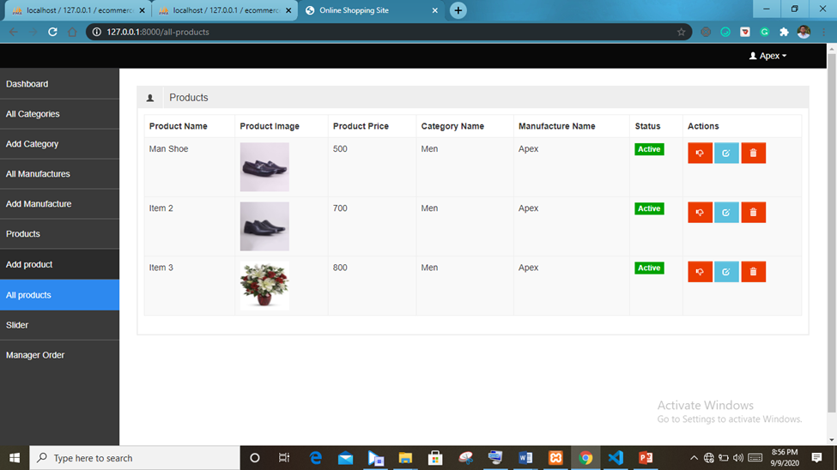
All products

Slide 28
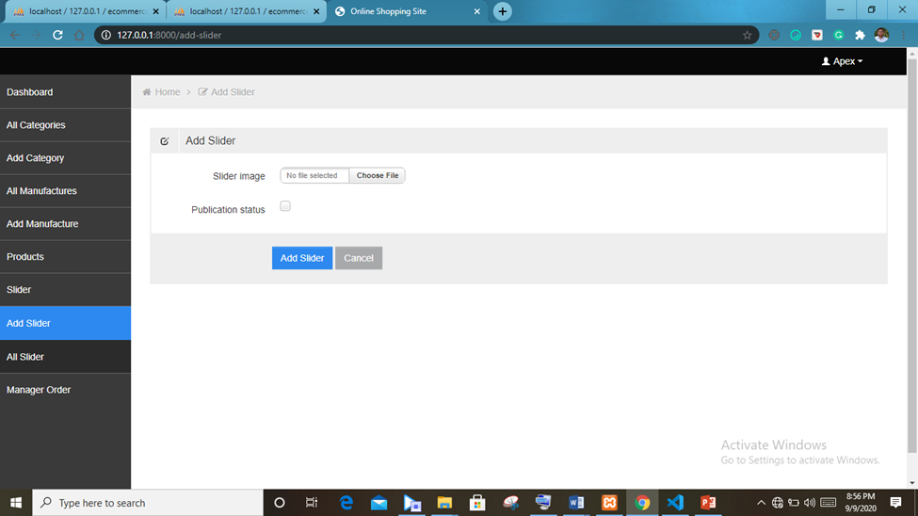
Add slider

Slide 29
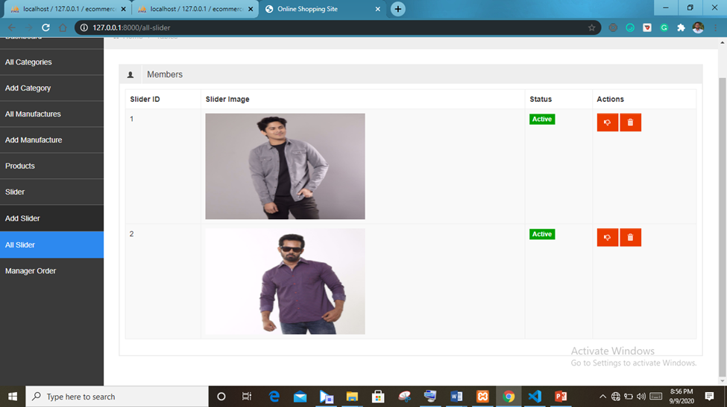
slider

Slide 30
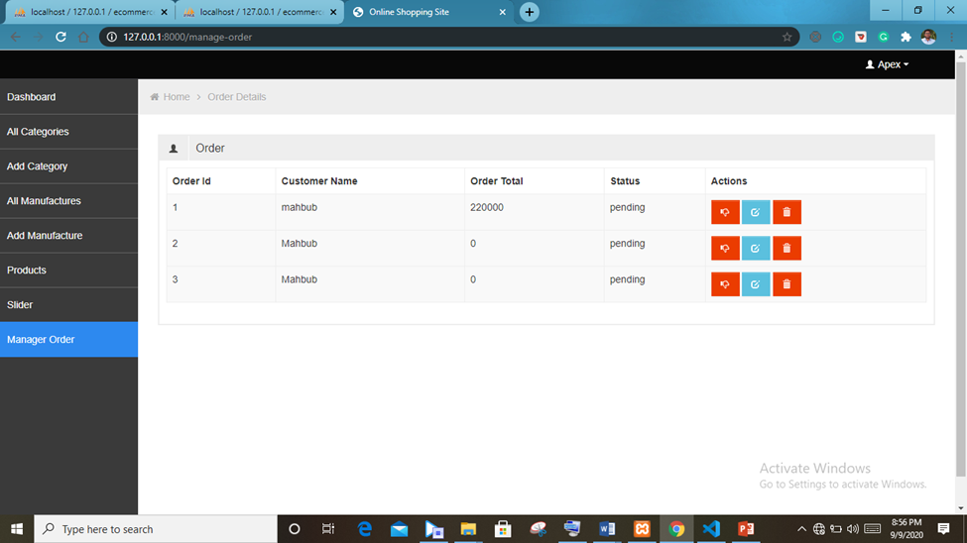
Order list

Slide 31
Limitations
Less Integrated system.
Page Design (Look and Feel) and color combination is not too lookative.
Security problem.

Slide 32
Future Scope
Provide security tor members.
A forum will be added in the web application for sharing opinions.
Framework will be used for developing the Web App easily.
System will be more integrated.
Database system will be improved.
System will be more dynamic.
AR (Augmented Reality) will be used for virtual trail.

Slide 33
Thank You

